Slide 1


Netflix Data Analysis and Visualization
This presentation details the cleaning, analysis, and visualization of Netflix data. We will use Python and Power BI. The goal is to derive insights from the dataset.
by Dheemanth Sunkara

Slide 2

Project Objectives
1
Data Import and Cleaning
Use Pandas in Python and Power BI to import and clean the dataset.
2
Trend Analysis
Analyze data trends and distributions using summary statistics and visualizations in Python.
3
Visualization
Create charts using Matplotlib and Seaborn in Python.
4
Dashboard Creation
Build a dynamic dashboard with Power BI for data exploration.

Slide 3
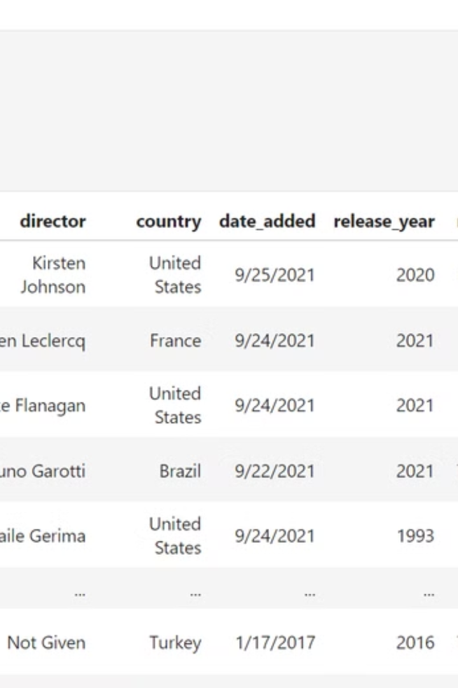
Importing Libraries
We will start by importing necessary Python libraries.
Pandas
NumPy
For data manipulation and analysis.
For numerical computations.
Matplotlib & Seaborn
For creating visualizations.

Slide 4
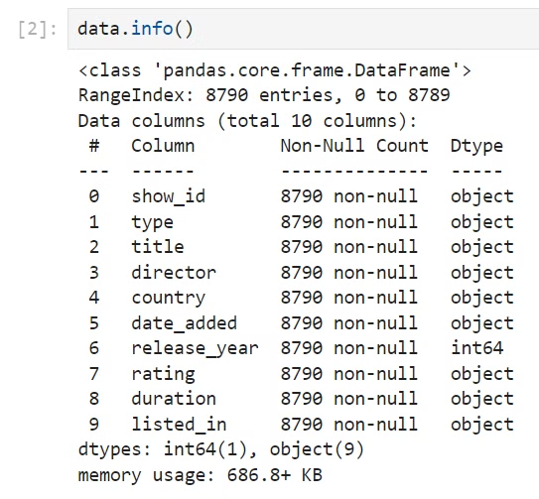
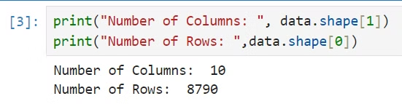
Dataset Overview
Data Information
Checking the dataset's info reveals datatypes and missing values.
Understand data structure
Identify columns
Note data types

Slide 5
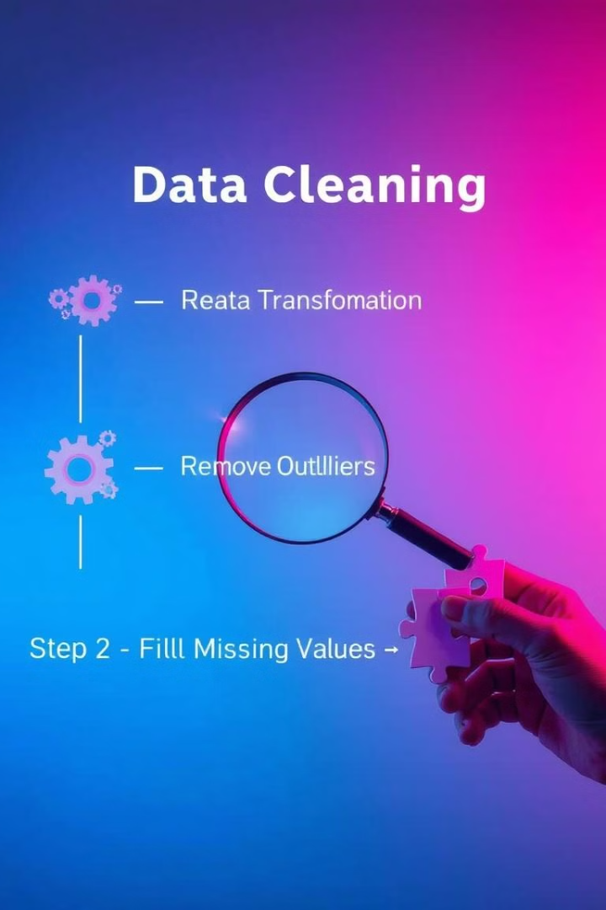



Data Cleaning Steps
Handle Missing Values
Address null values in relevant columns.
Convert Data Types
Ensure correct data types for analysis.
Remove Duplicates
Eliminate duplicate entries in the dataset.
Data cleaning ensures data quality for accurate analysis.

Slide 6
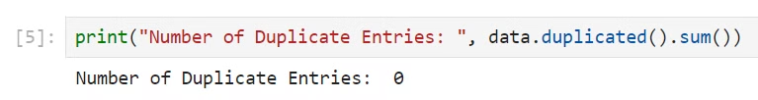



Duplicate Value Check
Identifying and removing duplicate values is a crucial step in data preprocessing.
Inspection
1
Initial data check
Detection
2
Identify duplicate entries
Removal
3
Eliminate redundancies

Slide 7

Data Visualization Overview
Visualizing data helps to identify trends and patterns.
1
Bar Charts
Compare categories.
2
Pie Charts
Show proportions.
3
Histograms
Analyze distribution.

Slide 8
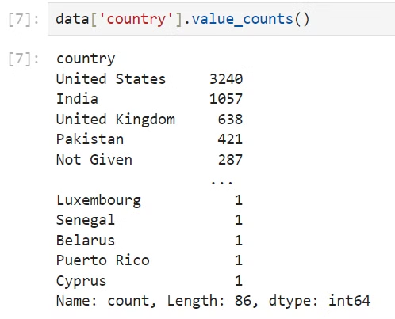
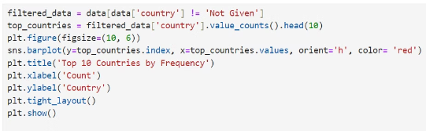
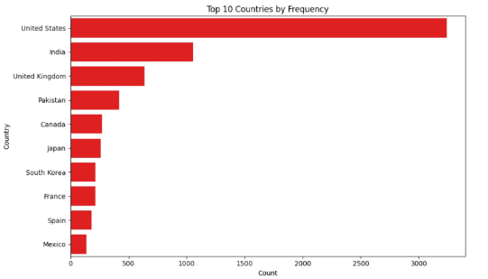
Top Countries by Users
Content Consumption
Visualizing user distribution by country helps understand content consumption patterns.

Slide 9
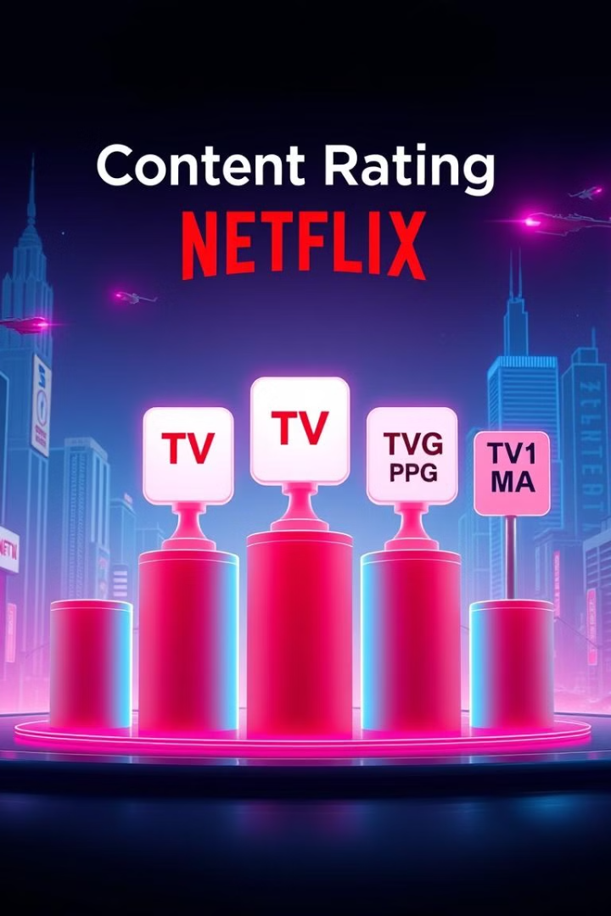



Content Rating Analysis
Popular Ratings
Target Audience
Rating Trends
Analyzing content ratings provides insights into the types of shows and movies that are most popular.

Slide 10
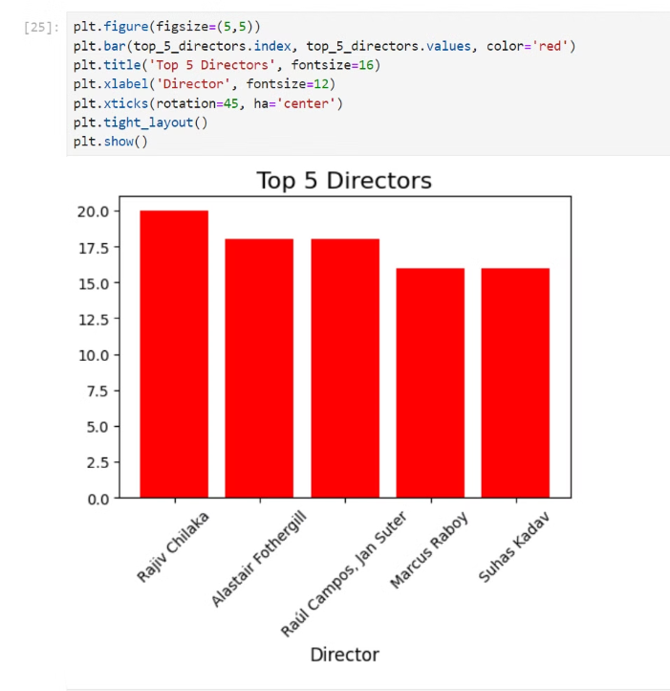
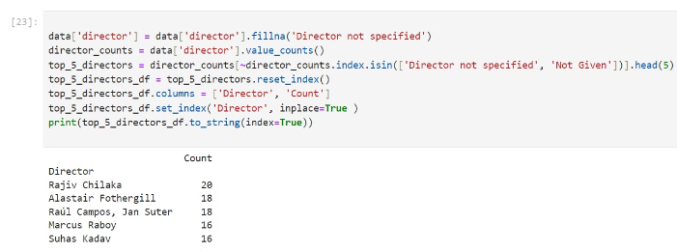
Top Directors Analysis
Director Influence
Identifying top directors can offer insights into Netflix's content strategy.
Production volume
Content type

Slide 11
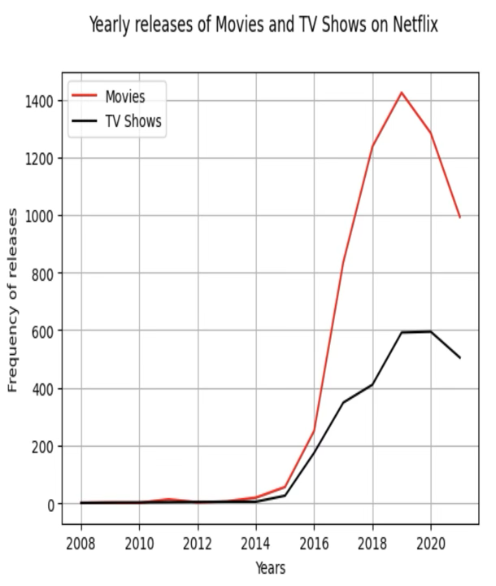
Netflix Content Analysis: Yearly Releases and Key Insights
A data-driven analysis of Netflix's content library, focusing on release trends and key insights. This presentation uncovers the platform's content strategy.

Slide 12
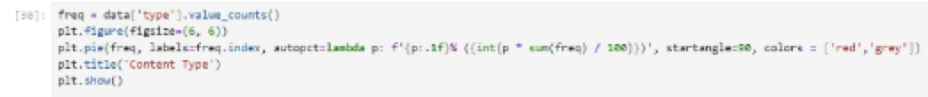
Content Volume by Type
Movies
TV Shows
69.7% of the Netflix catalog consist of Movies. This is equal to 6126 titles.
30.3% of the Netflix catalog consist of TV Shows. This is equal to 2664 titles.

Slide 13

Genre Popularity
International Dramas
Documentaries
362 titles
359 titles
Stand-Up Comedy
334 titles

Slide 14
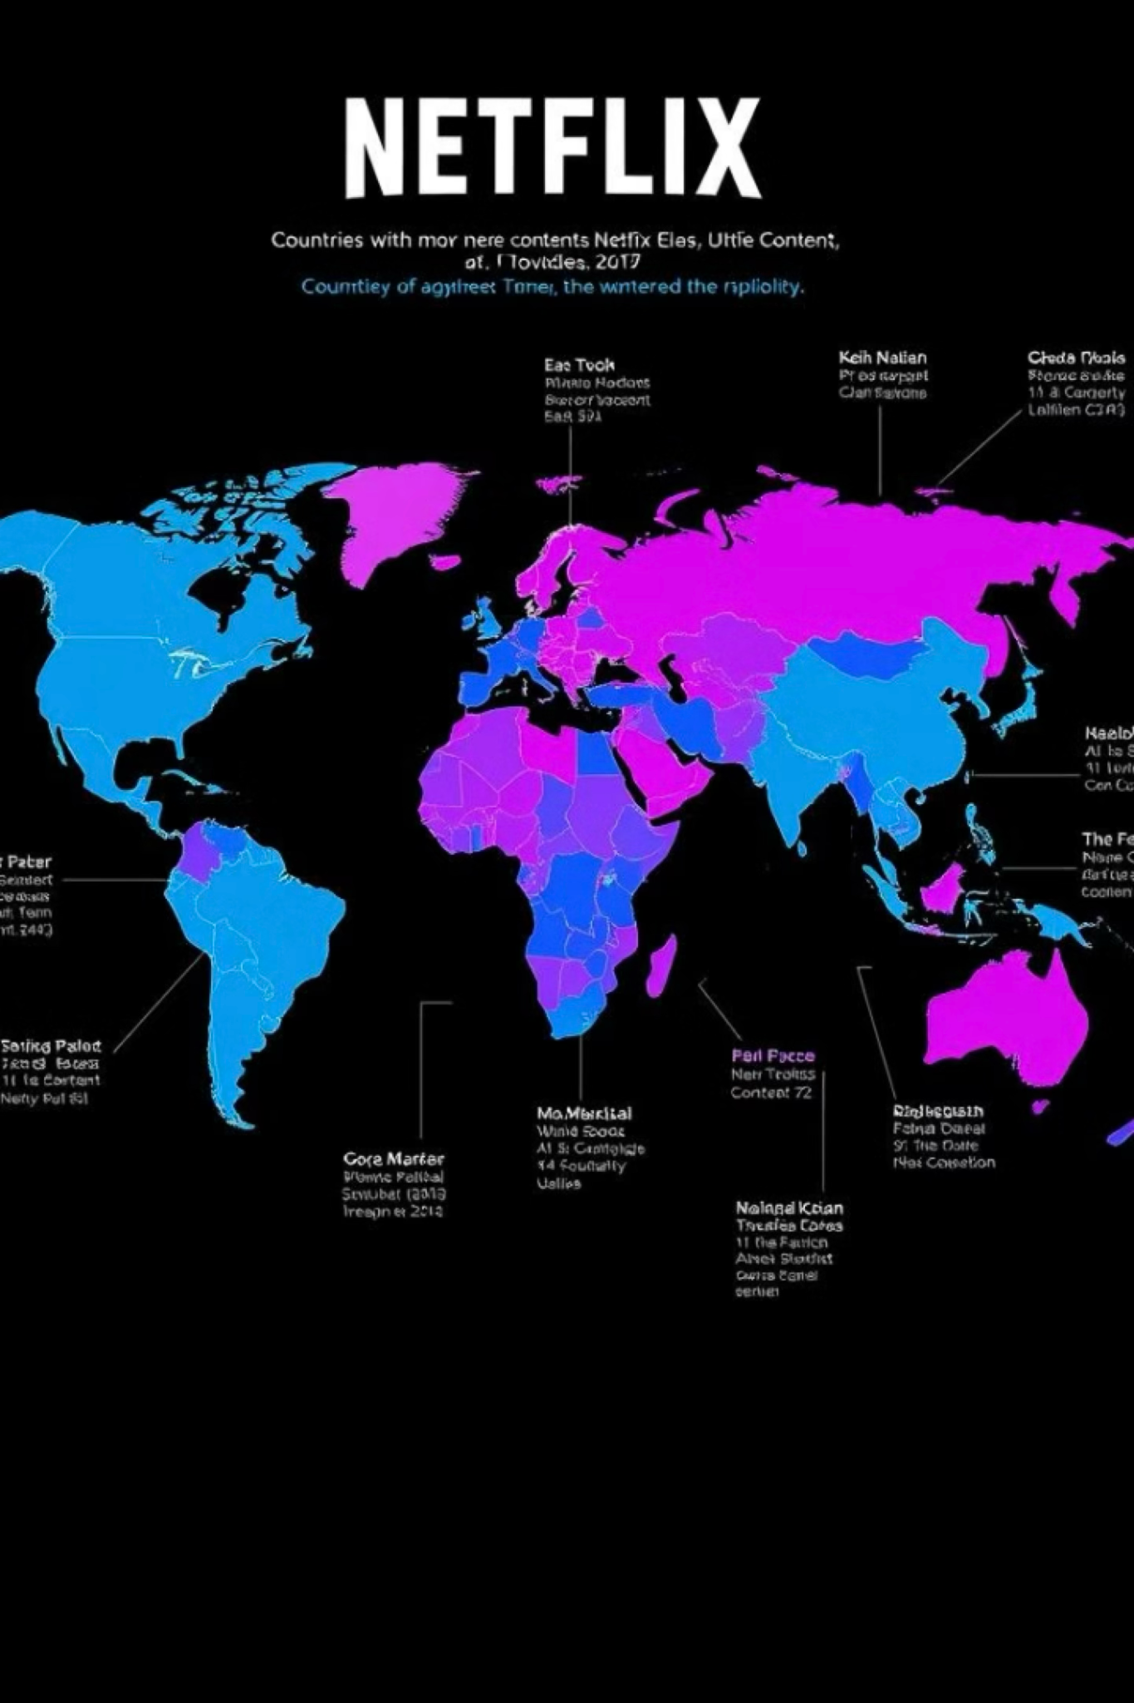
Top Content Producing Countries
1
United States
2
India
3
United Kingdom

Slide 15
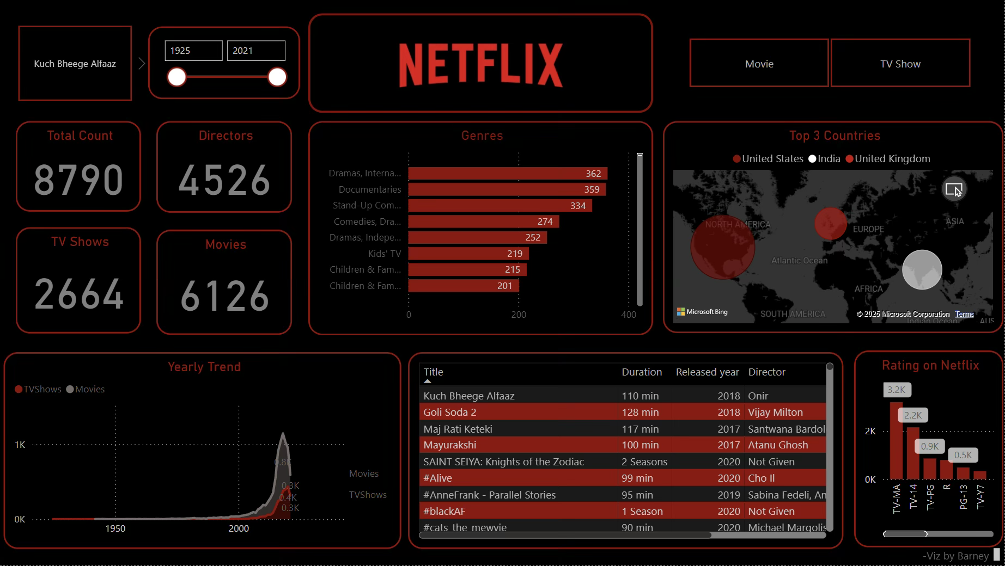
Content Rating Distribution
2
3

Slide 16

Key Takeaways
Data-Driven Insights
Improve Engagement
Shape content strategies
Attract bigger audiences
Platform Expansion
Shows content production growth

